Slide 1

Latent Dirichlet Allocation Tutorial in R
Presenter: Shreshtha Kulkarni

Slide 2
Topic Modeling (LDA) in R
Two main packages:
Topicmodels (Function: LDA)
Author: Gruen Bettina
Based on original LDA algorithm published by Blei D.M., Ng A.Y., Jordan M.I. (2003).
Incorporates Gibbs sampling
Lda (Function: lda.collapsed.gibbs.sampler)
Jonathan Chang and Andrew Dai
Based on Chang J (2010). lda: Collapsed Gibbs Sampling Methods for Topic Models
Notes:
Topic modeling in R consists of two packages topicmodels and lda. The respective functions are mentioned on the slide. Topicmodels is based on the original paper from authors of LDA algorithm Blei, Ng and Jordan and uses a Bayesian probabilistic model although it does provide an implementation of Gibbs sampling as well.
The other package is authored by Jonathan Chang and uses collapsed gibbs sampling methods. For the purpose of this tutorial we will explore LDA method from topicmodels.

Slide 3
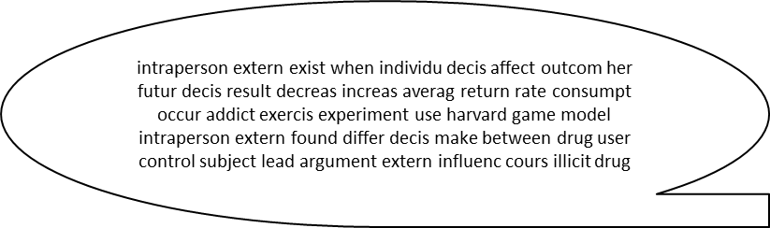
Corpus Creation & Preprocessing
library(tm)
library(topicmodels)
setwd("~/MSPA/CSC-529/project/corpus")
filenames <- list.files(path=".",
pattern = "*.txt")
#read lines from files
filetext<- lapply(filenames,readLines)
myCorpus<- Corpus(VectorSource(filetext))
removeComment <- function(x) gsub('### (abstract|introduction) ###','',x)
myCorpus <- tm_map(myCorpus, content_transformer(removeComment))
removePH <- function(x) gsub('(CITATION|NUMBER|SYMBOL)','',x)
myCorpus <- tm_map(myCorpus,content_transformer(removePH))
myCorpus <- tm_map(myCorpus, content_transformer(removePunctuation))
myCorpus <- tm_map(myCorpus,content_transformer(tolower))
myCorpus <- tm_map(myCorpus, content_transformer(removeNumbers))
toSpace <- content_transformer(function(x, pattern) { return (gsub(pattern, " ", x))})
myCorpus <- tm_map(myCorpus,toSpace,"\\\n")
#myCorpus <- tm_map(myCorpus, removeWords, # stopwords(kind="en"))
myStopwords = c("of","a","and","the","in","to","for","that","is","on","are","with","as","by","be","an", "which", "it", "from", "or", "can", "have", "these","has","such")
myCorpus <- tm_map(myCorpus,removeWords,myStopwords)
myCorpus <- tm_map(myCorpus,stripWhitespace)
#stem documents
myCorpus <- tm_map(myCorpus,stemDocument)
writeLines(as.character(myCorpus[[1]]))
Dataset: Sentence classification – UCI Machine Learning repository
30 articles, 10 each from domains biology, ML and psychology selected
“tm” package used for preprocessing and corpus creation.
Basic preprocessing applied like removing punctuations, stopwords, numbers, commented lines etc.
Stemming to reduce words to base form
Notes:
This corpus was extracted from the Sentence Classification dataset on UCI Machine learning repository. It consists of abstract and introduction paragraphs of 300 different articles in the domains biology, ML and psychology. 30 articles were chosen randomly 10 from each domain.
They were converted to corpus as per the code shown here.
Tm package was used for the corpus creation and preprocessing since topicmodels build upon this and hence data structure compatibility will not be an issue.

Slide 4
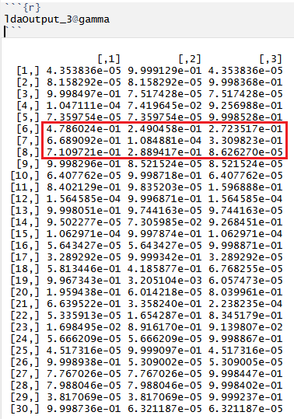
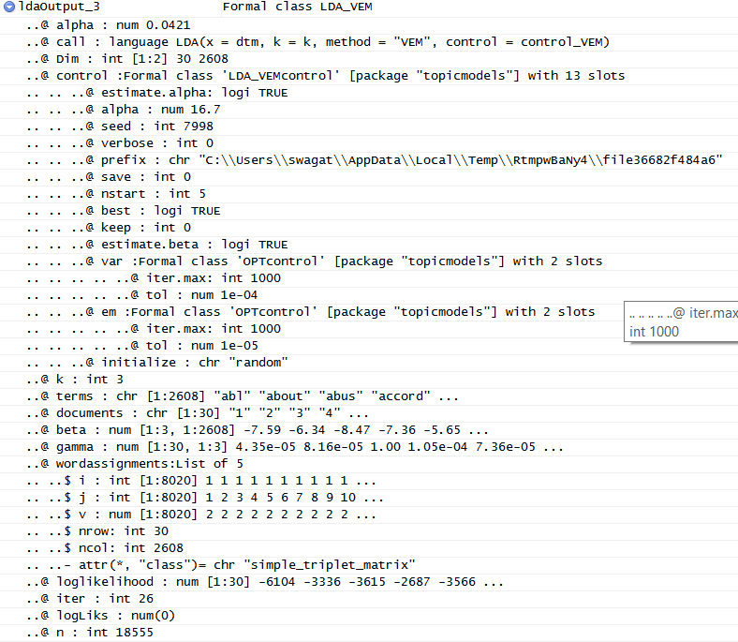
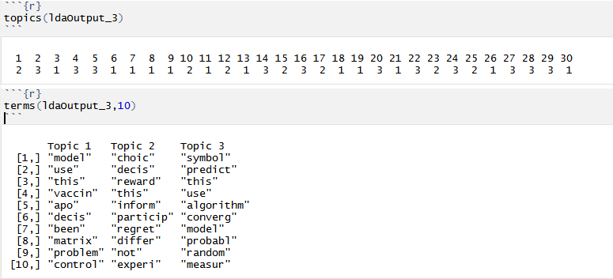
topicmodels::LDA
control_VEM <- list(nstart=5,seed=sample.int(10000,5),best=TRUE, em=list(iter.max=1000,tol=10^-5), var=list(iter.max=1000,tol=10^-4))
k <- 3
ldaOutput_3 <- LDA(dtm,k,method="VEM",control = control_VEM)
ldaOutput_3@Dim
Input:
document matrix (term frequency weighted)
No. of topics (fixed a-priori)
Fitting method (two available OOB)
VEM (Variance Expectation Maximization)
Gibbs (GIBBS Sampling)
User defined fitting function can be specified
Control (optional)
Set of hyper-parameters according to fitting function used
Can be specified as list or S4 object
Output:
S4 object of class LDA
@beta: word to topic distribution matrix
@gamma: topic to document posterior probability matrix
@loglikelihood: when VEM method is used returns log-likelihood of each document given parameters for topic and word distribution
topics(<LDA output object>)
terms(<LDA output object>, no of terms)
control_gibbs <- list(nstart=5,seed=sample.int(10000,5),burnin=2000, thin=500,iter=4000,best=TRUE,delta=0.15,
estimate.beta=TRUE)
k<-3
ldaOutput_gibbs_3 <- LDA(dtm,k,method="Gibbs",control=control_gibbs)
Notes:
Here we list the input parameters accepted by this method which are the document term matrix , no of topics to model, fitting method which defaults to Variance Expectation Method or VEM and control parameters depending upon function selected this however is optional. We also have model as an additional parameter where we can provide prefitted model.
on the right are code snippets for each function and we have provided some of the control parameters which I’ll describe in detail in further slides but if we see the output of VEM we can see some more parameters like save and keep which are essentially meant to save the intermediate results and initialize determines how topics are initialized. We can also see that output returns a bunch of other stuff which I’ll explain in next slide.
The output of Gibbs sampling differs slightly in terms of control parameters e.g. estimate.alpha is replaced by delta here mainly due to algorithmic differences and it returns the maximum log-likelihood amongst all documents whereas VEM would return for all documents.

Slide 5
Topicmodels::LDA Control-parameters
Method VEM
Default beta and alpha are estimated.
Initial value of alpha = 50/k
Estimate.beta=FALSE : useful for evaluating
fitted models on hold-out set when term
distribution is known
Var,em: control the assessment of convergence of
variational inference step and EM algorithm step
nstart: nstart indicates number of repeated runs
Seed: seed for each run (length = nstart), for reproducibility
Best: if TRUE, only best model w.r.t. log-likelihood is returned.
control_LDA_VEM <- list(estimate.alpha = TRUE,
alpha = 50/k, estimate.beta = TRUE, verbose = 0, prefix = tempfile(), save = 0, keep = 0, seed = as.integer(Sys.time()), nstart = 1, best = TRUE,
var = list(iter.max = 500, tol = 10^-6),
em = list(iter.max = 1000, tol = 10^-4),
initialize = "random")
Notes:
By default the parameters of Dirichlet distribution , beta for term distribution and alpha for topic distribution are estimated with initial value of alpha held at 50/k as suggested by Griffith and Steyvers. We can however, stop the estimation of alpha in which case it will be held constant at initial value. Estimate.beta = FALSE would only make sense when we have prior knowledge of term distribution may be from a previously fitted model. Since VEM algorithm uses variational posterior instead of true ones it uses two steps one where for each document optimal values for variational parameters is determined and second where the lower bound of log-likelihood of model w.r.t. alpha and beta is maximized. Var controls the convergence of former and em controls the convergence of latter.
Nstart gives no of repeated runs with random initializations and we can use seed for reproducibility. So intuitively we need to provide as many seeds as the runs. BEST= TRUE indicates that only best model needs to be saved.In addition, we have initialize which controls the initialization of topic distribution, which if “random” is initialized randomly, if”seeded” initialized from a distribution smoothed over randomly chosen document(s) and if “model” expects a prefitted model to be provided which will then be used to initialize the dist.

Slide 6
Topicmodels::LDA Control-parameters
control_LDA_Gibbs <-
list(alpha = 50/k,
estimate.beta = TRUE,
verbose = 0, prefix = tempfile(), save = 0, keep = 0,
seed = as.integer(Sys.time()),
nstart = 1, best = TRUE, delta = 0.1,
iter = 2000, burnin = 0,
thin = 2000)
Method Gibbs
All parameters are same except for the
ones mentioned below
Delta: prior distribution of term distribution over
topics. Default = 0.1
Burnin: first few iterations to be discarded
Iter: no of iterations to be performed after burnin
Thin: the iteration to be returned for iter iterations.
Best: if FALSE, all draws are returned. If TRUE, highest posterior likelihood result is returned.
Notes:
Since, Gibbs sampling works in a way of random sampling from conditional distribution analogous to random walk the control parameters are slightly different. Since we start from a random point we discard the first few steps/iterations since they do not correctly estimate the joint distribution. We perform iter no of iterations thereafter choosing the thin nt iteration for further use.
Notice here the alpha is not estimated but is fixed at 50/k by default or any user provided value. Also, the prior term distribution over topics is specified by delta.
Rest of the parameters remain same as the VEM algorithm.
Gibbs sampling tries to find a locally optimal solution at best and hence it is important to do lot of runs with different values of above parameters to see if the solution tends to converge and the results are available.

Slide 7
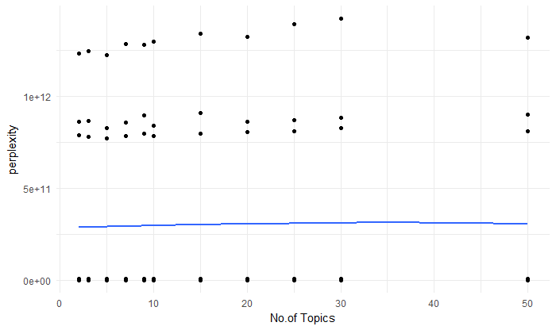
Model Selection & Inference
results <- matrix(ncol=2,nrow=0)
colnames(results) <- c("k","perplexity")
for(k in k_vals) {
results_k <- matrix(ncol=2,nrow=0)
colnames(results_k) <- c("k","perplexity")
for(i in 1:10) {
trainSet <- dtm[splitfolds != i,]
testSet <- dtm[splitfolds == i,]
ldaOutout <- LDA(trainSet,k=k,method = "VEM",control=list(nstart=5,
seed=sample.int(10000,5),best=TRUE,em=list(tol=10^-5),
var=list(tol=10^-4)))
results_k <- rbind(results_k,c(k,perplexity(ldaOutout,newdata = testSet)))
}
results <- rbind(results,results_k)
}
Helper functions to analyze the performance of model
loglik(): obtains log-likelihood of fitted model
perplexity(): determines how well model fits over new data. Lower values are better.
posterior(): gives topic distribution over documents and term distribution over topics.
Need to experiment with different values for k for minimum perplexity.
One-way to determine is iterate the model over range of values for k using n-fold cross validation.
Another package ldatuning provides function for finding optimum no of topics and also some utility plot functions for visualization.
Notes:
Next couple of slides will deal with making sense of the LDA model as spitted by R and the variations that we discussed in previous slides. There are a bunch of helper functions available in the package which help us analyze the performance or fit of the model. E.g. loglik gives the log-likelihood of fitted model and perplexity measures the performance of model over new data. It is equivalent to the geometric mean per word-likelihood. Lower values are better. Another useful function is posterior which gives topic distribution over documents where we can see the composition of document and whether any particular topic is assigned with high probability.
This package however doesn’t provide any helper function for selecting optimum no of topics. However, it can easily be done programmatically by iterating model over range of values with n-fold cross validation and evaluating the perplexity at each step. Alternatively, we can use another function ldatuning which provides such function however, it has not been used for this tutorial.
Using the programmatic approach, we experimented with range of values for topics and the graph here shows the plot of perplexity at each step with the no of topics. We can see that there isn’t much variation with no.of topics however lower values seem marginally better.

Slide 8
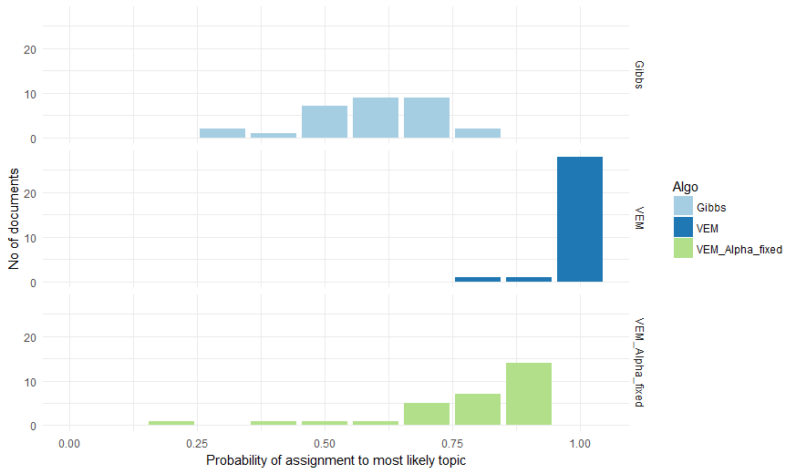
Inference
k <- 7
seeds <- sample.int(10000,5)
nstart <- 5
best <- TRUE
em <- list(iter.max=1000,tol=10^-5)
init <- "seeded"
lda_vem_est_all <- LDA(dtm,k,method="VEM",control=list(nstart=nstart,seed=seeds,best=best,em=em,initialize=init))
lda_vem_fix_alpha <- LDA(dtm,k,method="VEM",control=list(nstart=nstart,seed=seeds,best=best,em=em,alpha=7, estimate.alpha=FALSE))
burnin <- 4000
iter <- 2000
thin <- 500
lda_gibbs <- LDA(dtm,k,method="Gibbs",control = list(nstart=nstart, seed=seeds,iter=iter,burnin=burnin,thin=thin, best = best))
Experimented with bunch of values between 2 to 50 for no. of topics
Fit doesn’t show much variance with no.of topics so arbitrarily chose 7 topics to model.
Three models were created:
Using VEM with alpha and beta estimated.
Using VEM with alpha fixed at 50/7
Using Gibbs sampling
VEM with estimated value of alpha gave the best results as the probability of documents being assigned to one topic is high.
VEM also gave lowest value for alpha so we can say lower the alpha higher is the % of documents assigned to one single topic with high probability
We can also inspect the n most frequent terms given by each algorithm and see what makes logical sense.
Notes:
Hence we randomly selected 7 as number of topics to be modelled from the results in previous slide and created three models with method VEM and all hyperparameters estimated, VEM with alpha remained constant at 50/7 and Gibbs sampling with beta estimated and delta at default value of 0.1. The graph below shows us the probability of assignment of most likely topic in each document for all the three models. Light blue is gibbs , middle dark blue is VEM with estimated parameters and green one is VEM with constant alpha. We can see that VEM with estimated parameters mostly classifies documents to a single topic while other models have more evenly distributed topics. When we analyse the final alpha values for all 3 models we see that the VEM with estimated parameters give the lowest alpha. Hence we can conclude that lower alpha values tends to converge the topic to document distribution. However, it would make sense to review the n most frequent terms in each model to see what makes more logical sense since our initial assumption was that a document may consists of multiple topics.
This concludes our tutorial for R and we have seen that topicmodels package is a fairly well documented package and provides flexibility of modeling over documents with multiple functions provided to support the model selection and inference. The function LDA however assumes that the topics are not correlated which may not be the case in real world. To model such documents topicmodels provides another function CTM which remains to be explored as future work.

